Slide 1
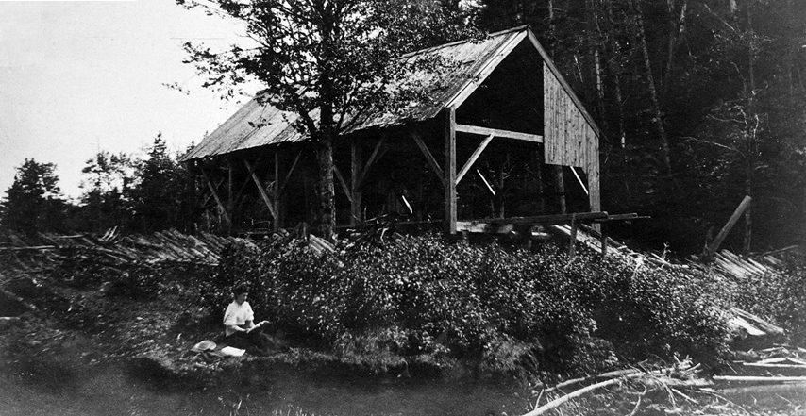
Wind, Water and Steam Power on the Bay of Fundy
A search for evidence of early mills
Kerr Canning

Slide 2
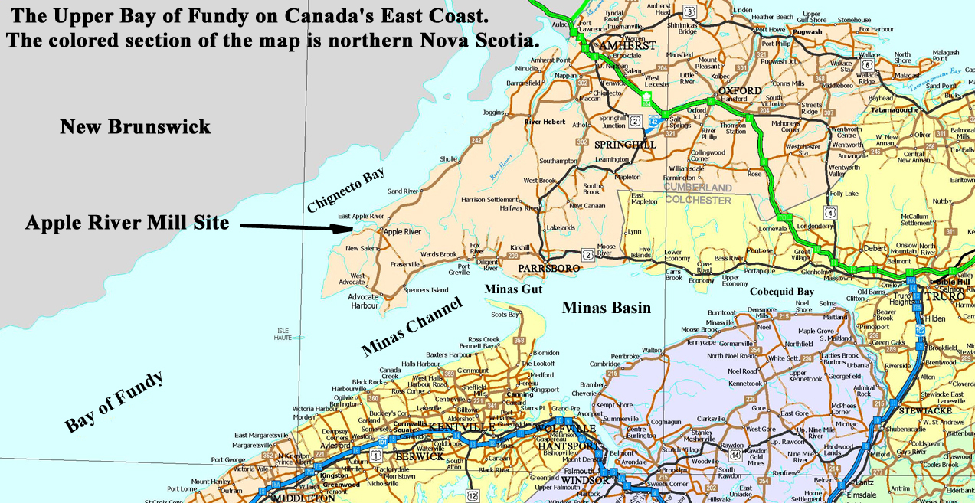
Chignecto Peninsula

Slide 3
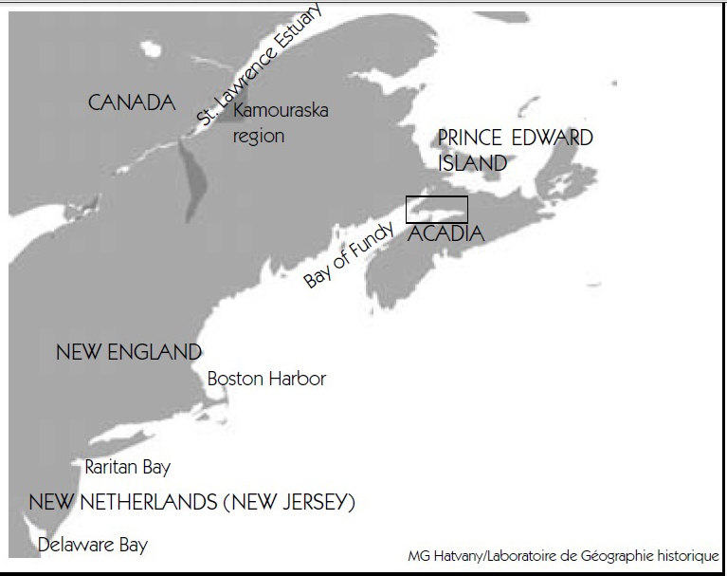
The southern part of the glaciated coast.
(Sebold 1992)
The Northeast region in the colonial epoch
(1600-1850). Recognition and exploitation
of the fertility of salt marshes was not
ethnocentric, but instead part of a larger
culture of wetland appreciation found across the entire Northeast. (Hatvany 2002)
Notes:
Hatvany, M. G. (2002). "The Origins of the Acadian Aboiteau: An Environmental-Historical Geography of the Northeast." Historical Geography 30, Page122
Available on the web at http://www.historical-geography.net/volume_30_2002/hatvany.pdf.
Sebold, K. R. (1992, ). "FROM MARSH TO FARM:
The Landscape Transformation of Coastal New Jersey." Historic American Buildings Survey/Historic American Engineering Record Retrieved 7 Sept.y 2014, from
http://www.nps.gov/history/history/online_books/nj3/contents.htm.

Slide 4
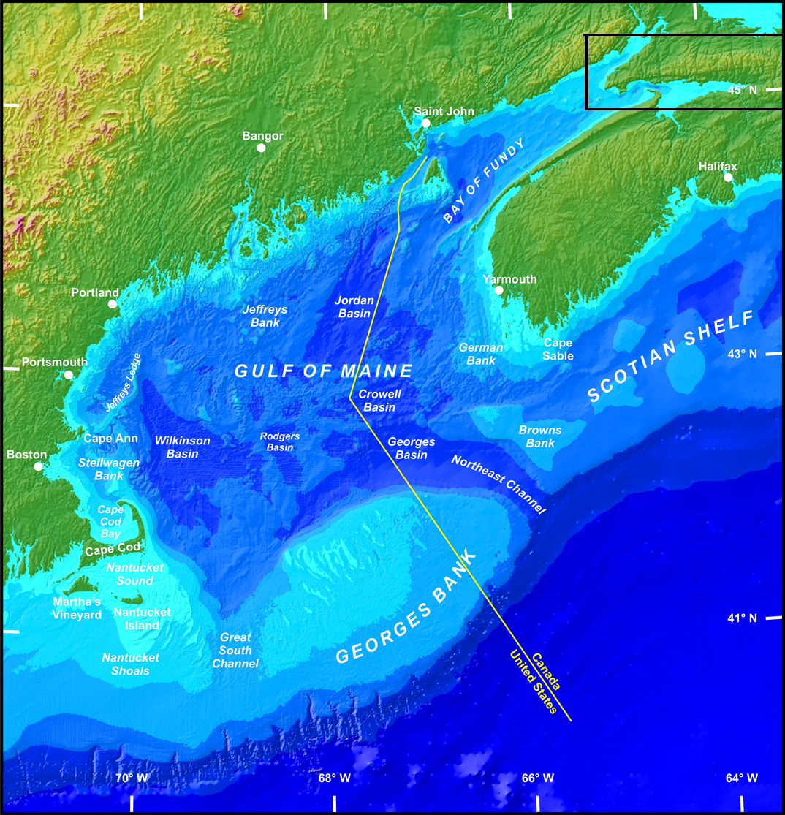
Notes:
Digital bathymetry map: This map, which appears on The Gulf of Maine Council on the Marine Environment home page, was created by Ed Roworth and Rich Signell of the U.S. Geological Survey (USGS). Read how they did it and view other versions.
This map can be obtained at
http://www.gulfofmaine.org/2/about-the-gulf/maps/

Slide 5
The Impact of Sea-Level Rise on Coastal Archaeological Sites
Contributing Factors to Sea-Level Rise for the Bay of Fundy: Subsidence of the Land Surface, Thermal Expansion, Melting Polar Ice Caps
The Impact: Archaeological Sites are threatened by shoreline retreat caused by increased erosion and storm surges.

Slide 6
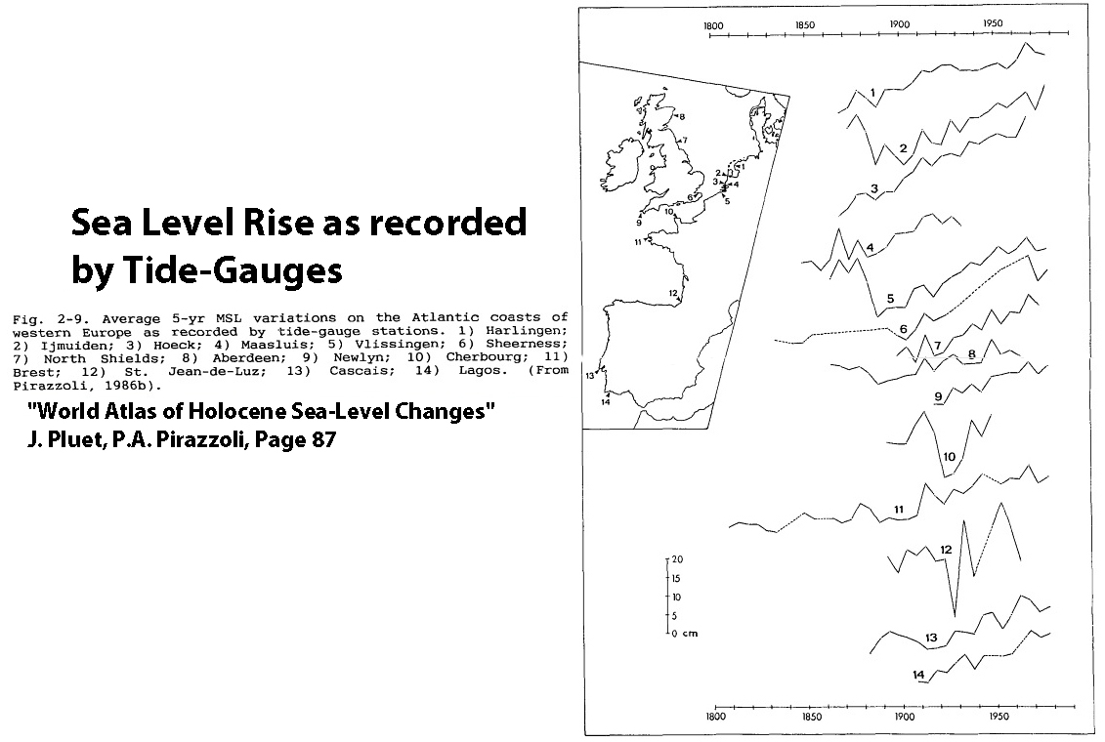
Notes:
Moreira, M. E. S. d. A. (1992). "Saltmarsh Changes and Sedimentation Rates in the Sado Estuary, Portugal. ." Journal of Coastal Research 8(3): 631 to 640.
http://journals.fcla.edu/jcr/article/view/78895
D. G. SanLe, J. I., J.M. Sanchez (1999). "Spartina patens as a weed in Galician saltmarshes (NW Iberian Peninsula)." Hydrobiologia 415: 213–222
http://link.springer.com/chapter/10.1007%2F978-94-017-0922-4_30#page-1
J. Pluet and P.A. Pirazzoli (1991). World Atlas of Holocene Sea-Level Changes. Amsterdam, Elsevier Science Publishers, B. V., Oceanography Series.
Robert J. Nicholls and Anny Cazenave (2010). "Sea-Level Rise and Its Impact on Coastal Zones." Science 328.
http://www.webpages.uidaho.edu/envs501/downloads/Nicholls%20%26%20Cazenave%202010.pdf

Slide 7
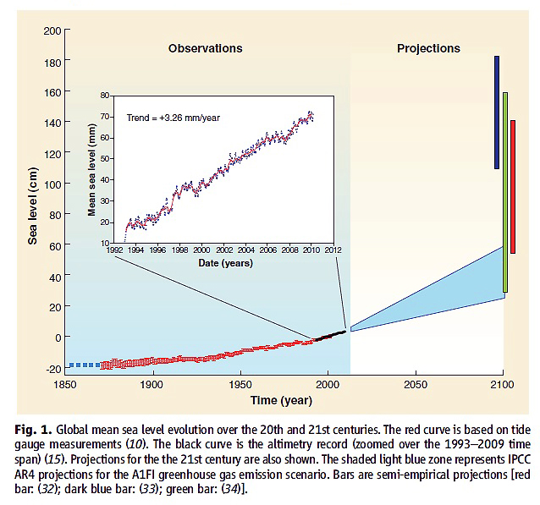
Sea-Level Rise and Its Impact on Coastal Zones
Notes:
Robert J. Nicholls and Anny Cazenave (2010). "Sea-Level Rise and Its Impact on Coastal Zones." Science 328.
On the web at
http://www.webpages.uidaho.edu/envs501/downloads/Nicholls%20%26%20Cazenave%202010.pdf

Slide 8
The Portuguese Connection
Champlain’s Discovery of an Iron Cross
Erosion, Invasive Plants and Sea Level Rise
A Portuguese Sailor Shipwrecked on the Coast of Nova Scotia in 1805.

Slide 9
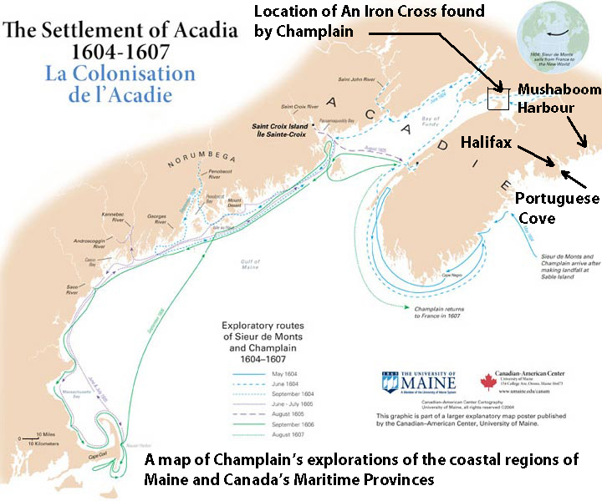
Notes:
A map of Champlain’s explorations of the coastal regions of Maine and Canada’s Maritime Provinces is taken from
http://umaine.edu/teachingcanada/instructional-resources-2/explanatory-maps-of-saint-croix-acadia/champlain-and-the-settlement-of-acadia-1604-1607/
Also see
Hunter, D. (2012). The Race to the New World: Christopher Columbus, John Cabot, and a Lost History of Discovery. Vancouver, Douglas & McIntyre, An imprint of D&M Publishers INC.

Slide 10
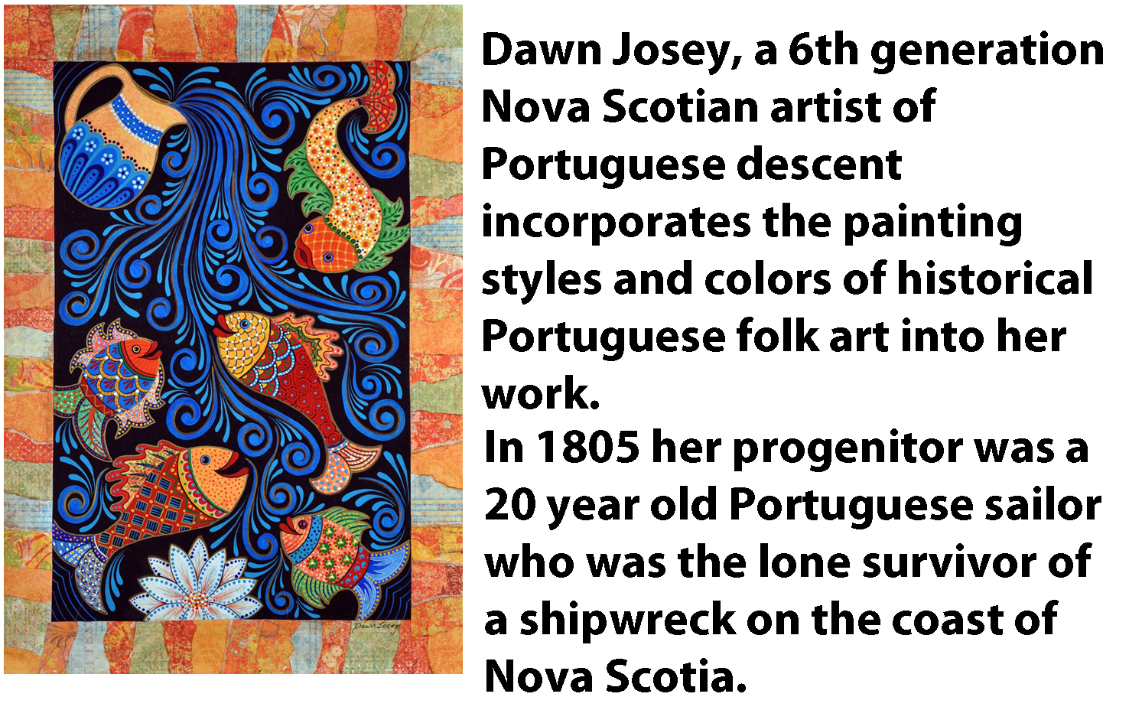
Notes:
http://www.findingyourcreativespirit.com/
My name is Dawn Josey an artist in Nova Scotia with a Portuguese connection. My work involves taking historical information and ancestral stories to create visual displays.
I am the 6th generation from the original progenitor of my family name in Nova Scotia.
From census information and other historical records we know that a Portuguese sailor onboard a ship sailing from Havana, Cuba to Liverpool, England was shipwrecked in 1805 off Mushaboom Harbour in Nova Scotia. He was 20 years old and the lone survivor.
He settled and live out his life in the same area as did the 5 generation before me.
Records indicate he was known as Manuel Jusey (Jose, Jewsie). With many different spellings. We know from one census that he was recorded as Manuel Figurehead which lead some genealogists to suspect his name may have been Figueiredo. As we know nothing of his parents we may never know his true history before arriving in Nova Scotia.
He was born in 1785 and died in May 1870 at age 85. He had 11 children.
His daughter records him as being from Lisbon Portugal.
The generations to follow recorded their nationality as Portuguese right up to and including my grandfather who passed in 1940. My father was the first generation to be recorded as Canadian on census information.
Over the years since he arrived in Nova Scotia he and his male children made a living on the sea as fisherman although they would have also supplemented their income working the woods for lumber. In later years they working in saw mills owned by the Alfred Dickie Lumber Company in Ship Harbour, Sheet Harbour, Sherbrook and Liscombe.
Many Portuguese recipes and culture have filtered down over the years including my passion for incorporating the painting styles and colors of historical Portuguese folk art into my own work.

Slide 11
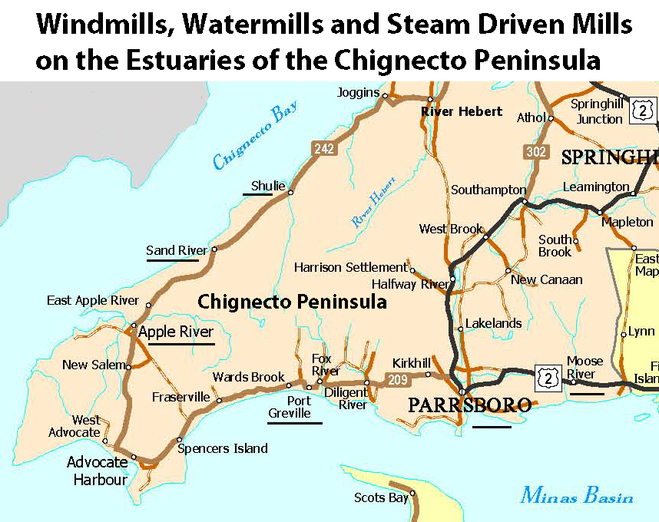

Slide 12
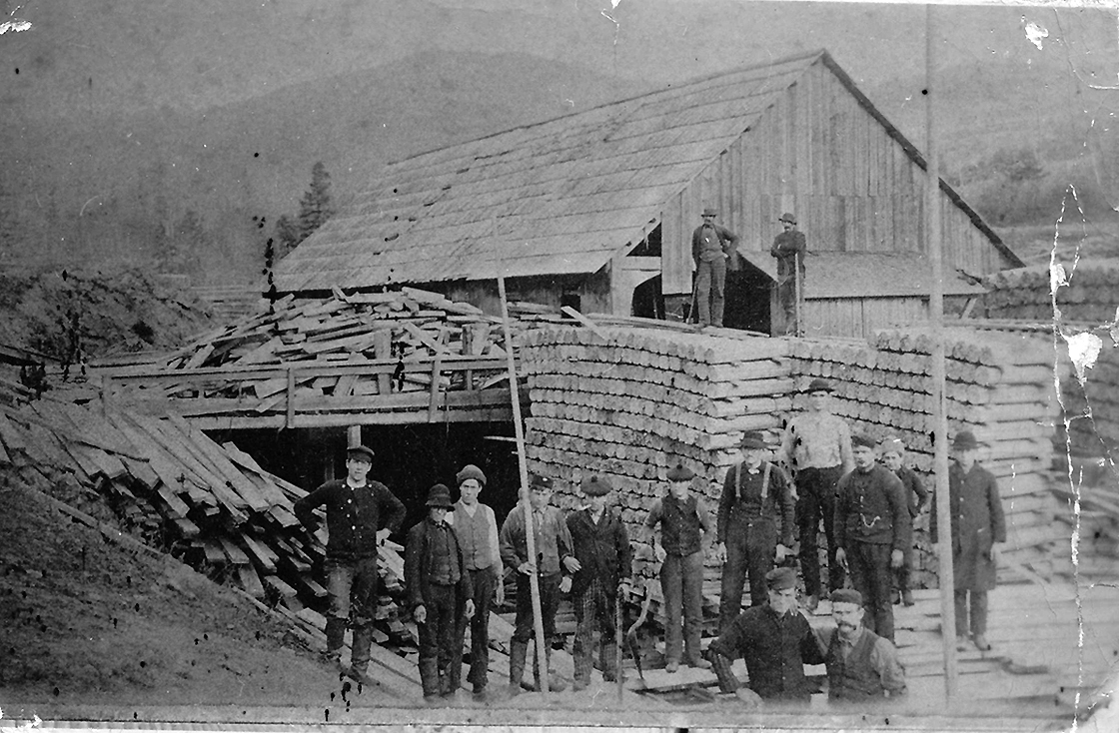
Port Greville/Ward’s Brook Water Mill

Slide 13
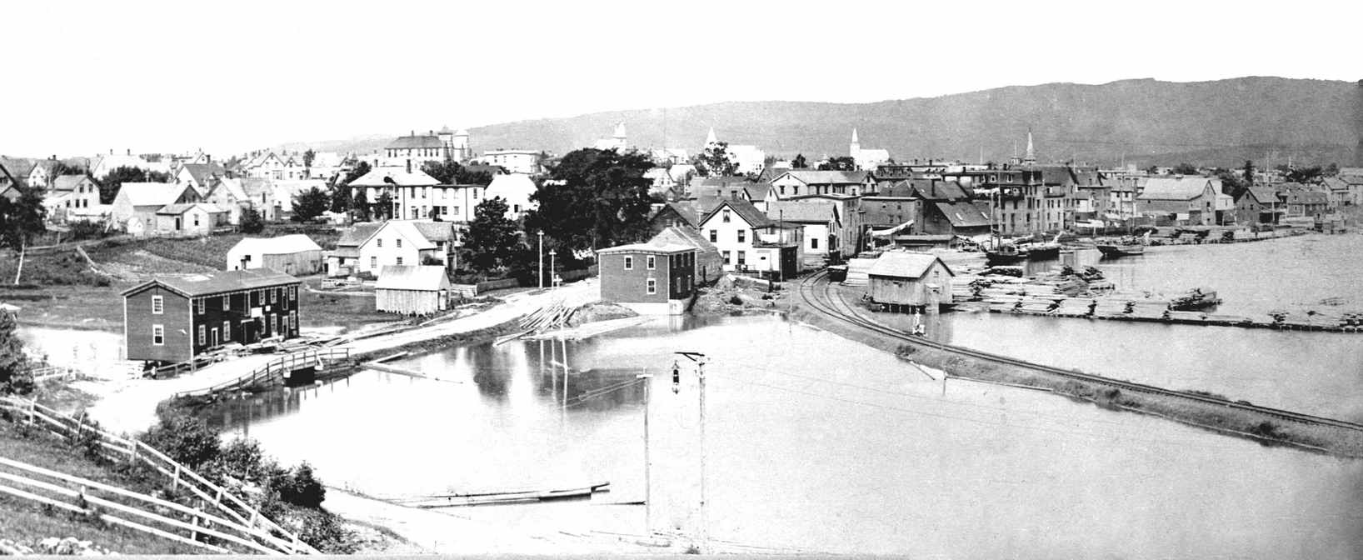
The Parrsboro Block, Pump and Furniture Tide Mill: It was later converted to steam.

Slide 14
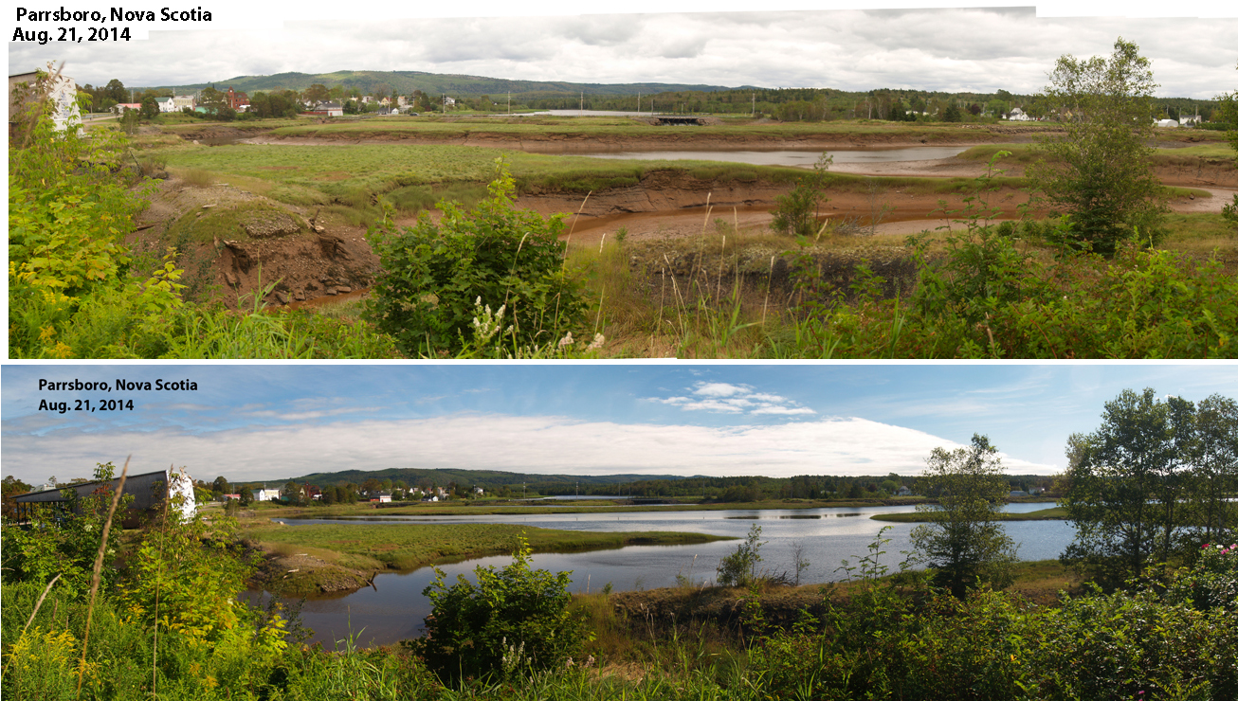
Possible Location of the Josiah Davison Tide Grist Mill Constructed Circa 1825 on a ¾ Acre Salt Marsh Lot

Slide 15
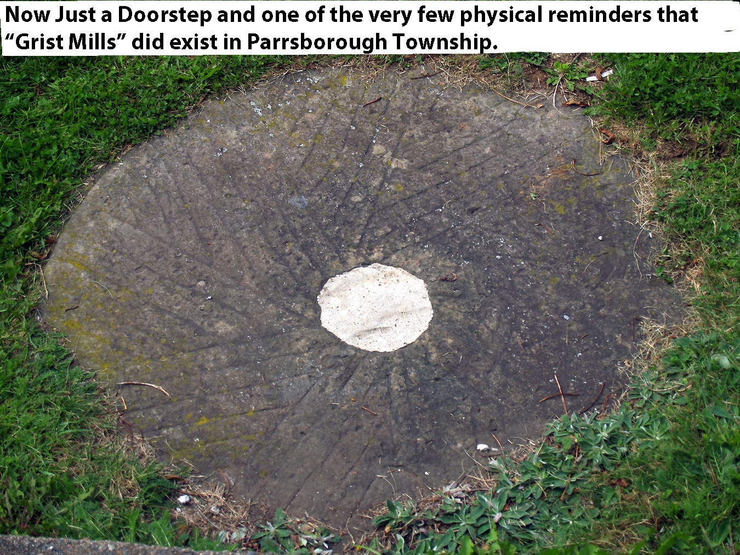

Slide 16
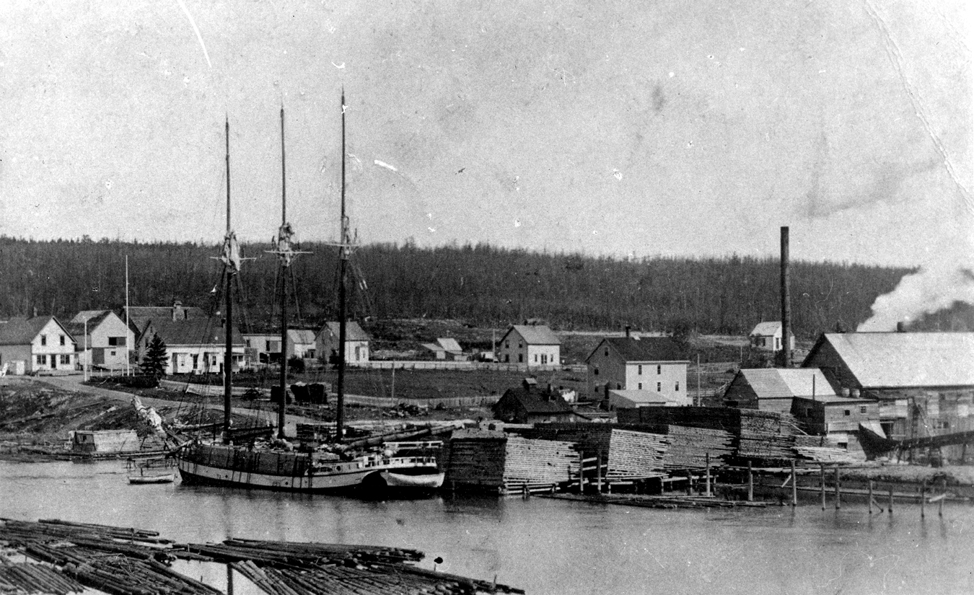
Sand River, Cumberland Co., Nova Scotia

Slide 17
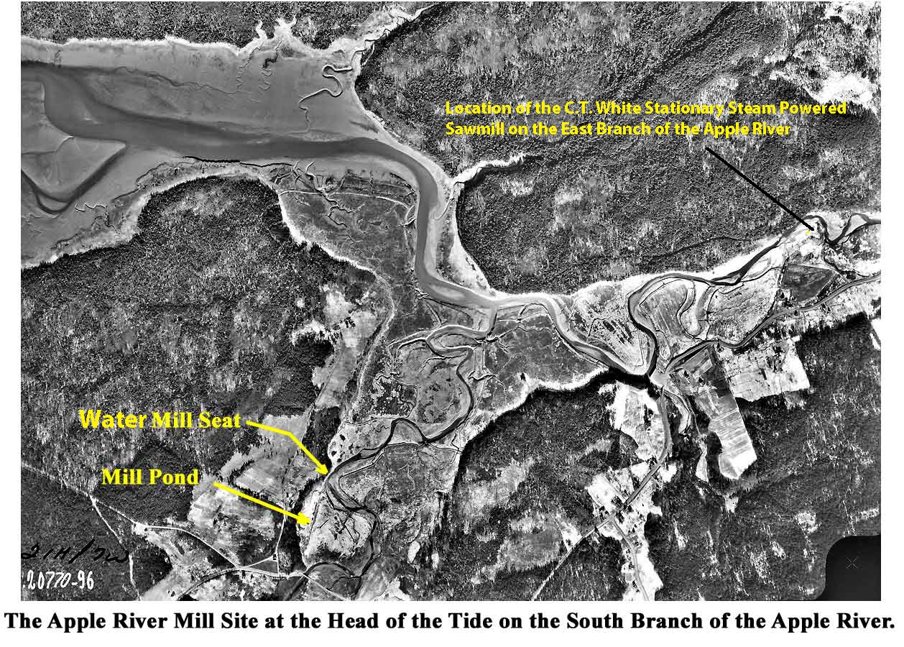

Slide 18
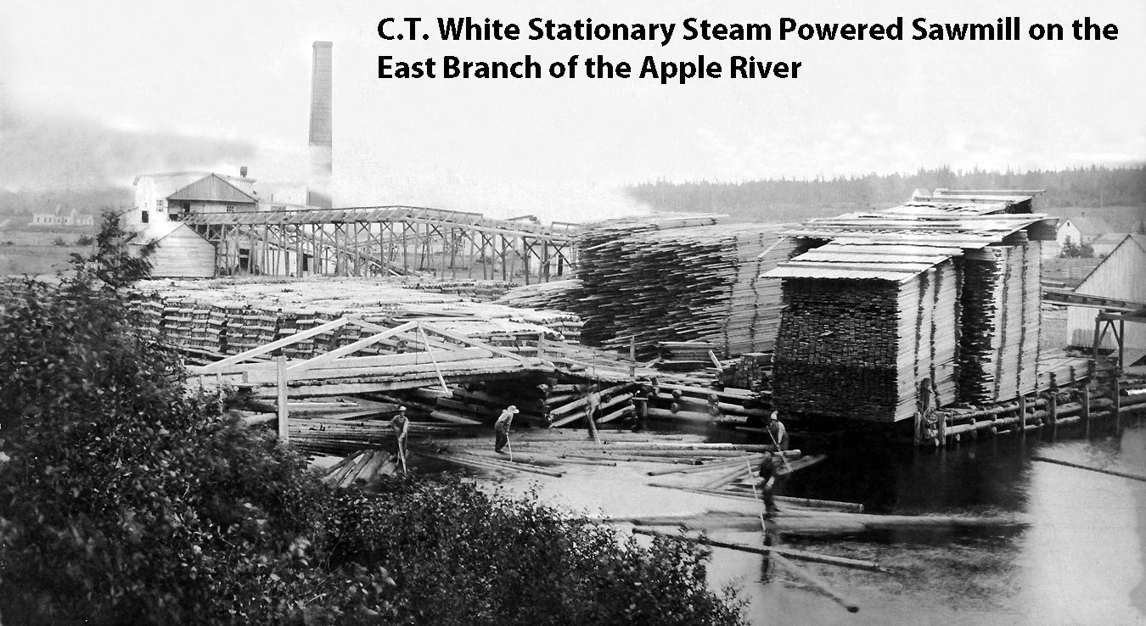

Slide 19
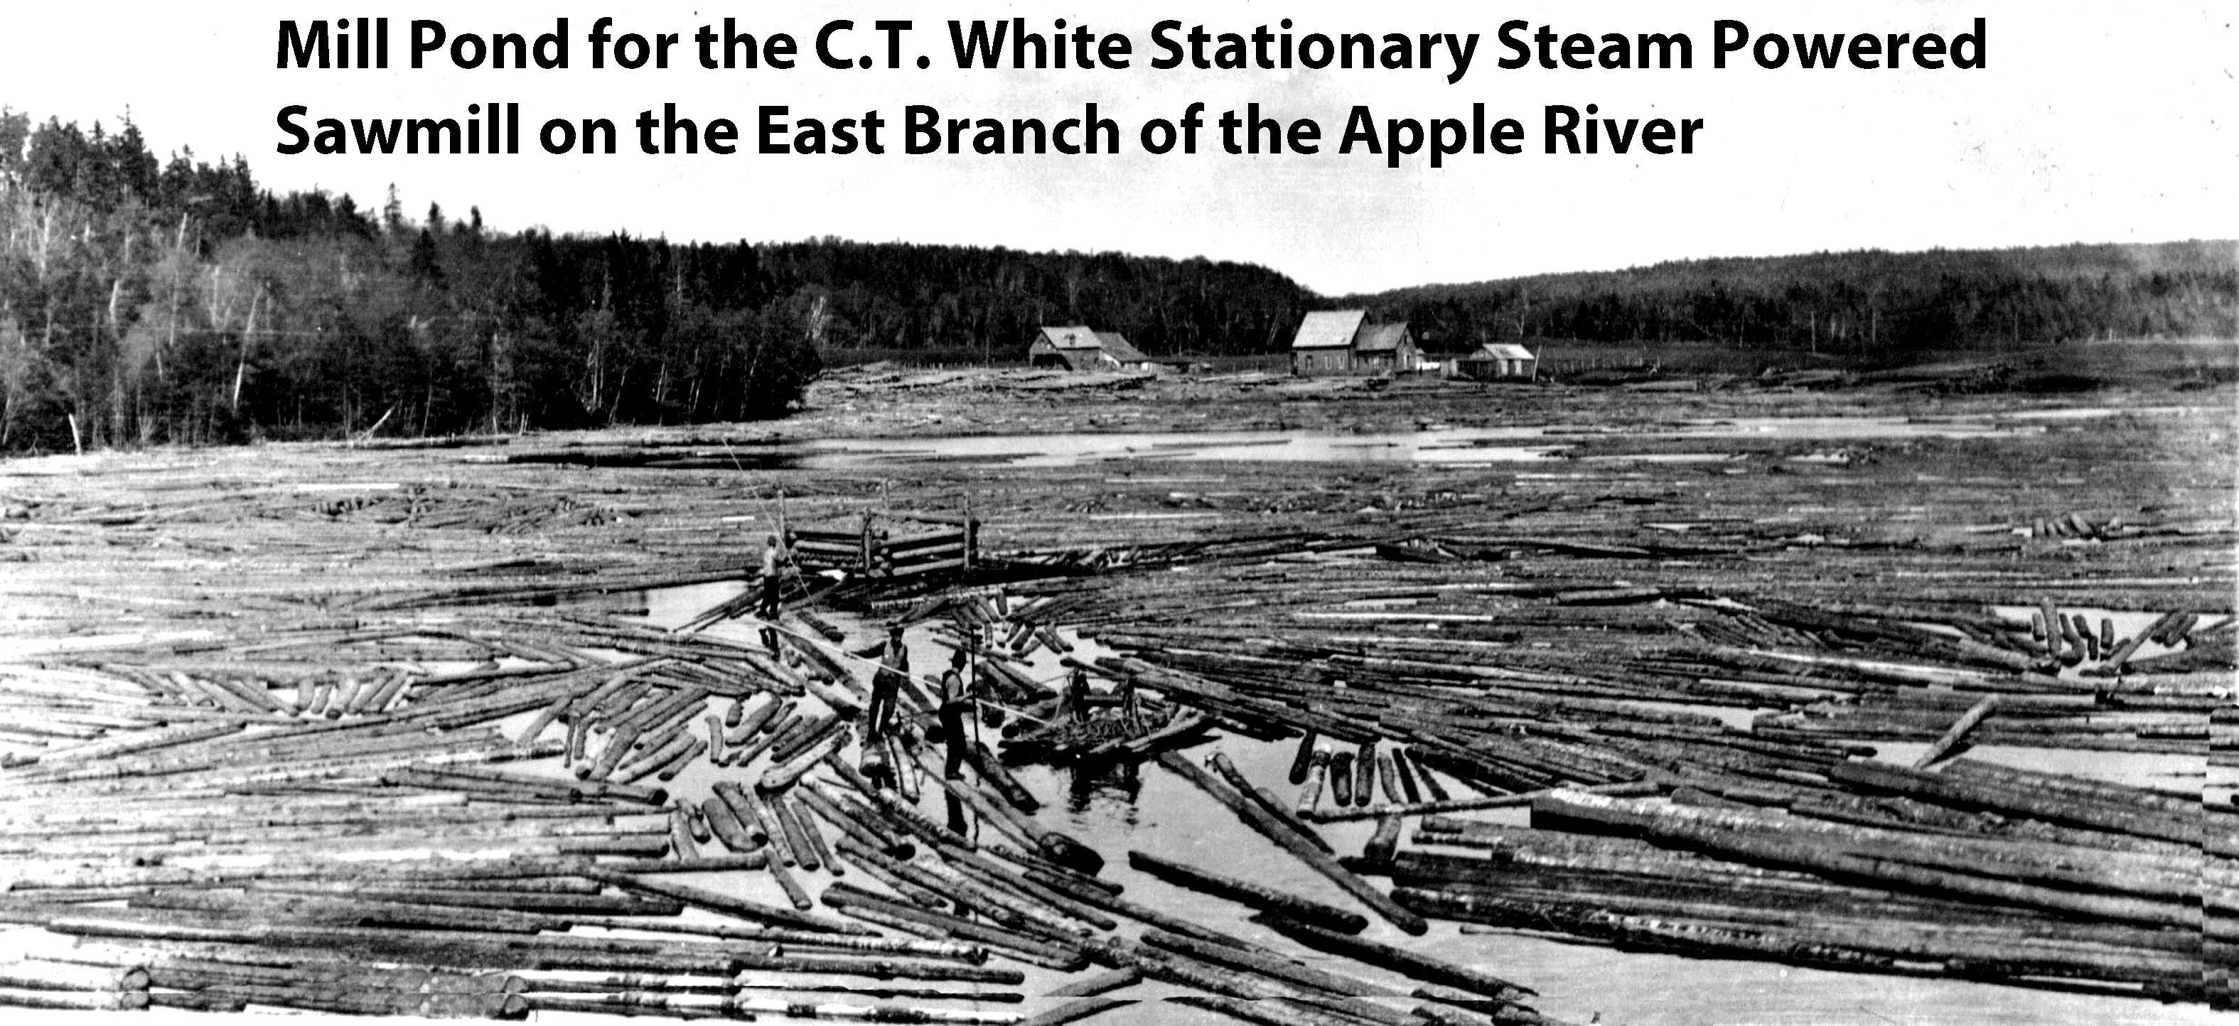

Slide 20
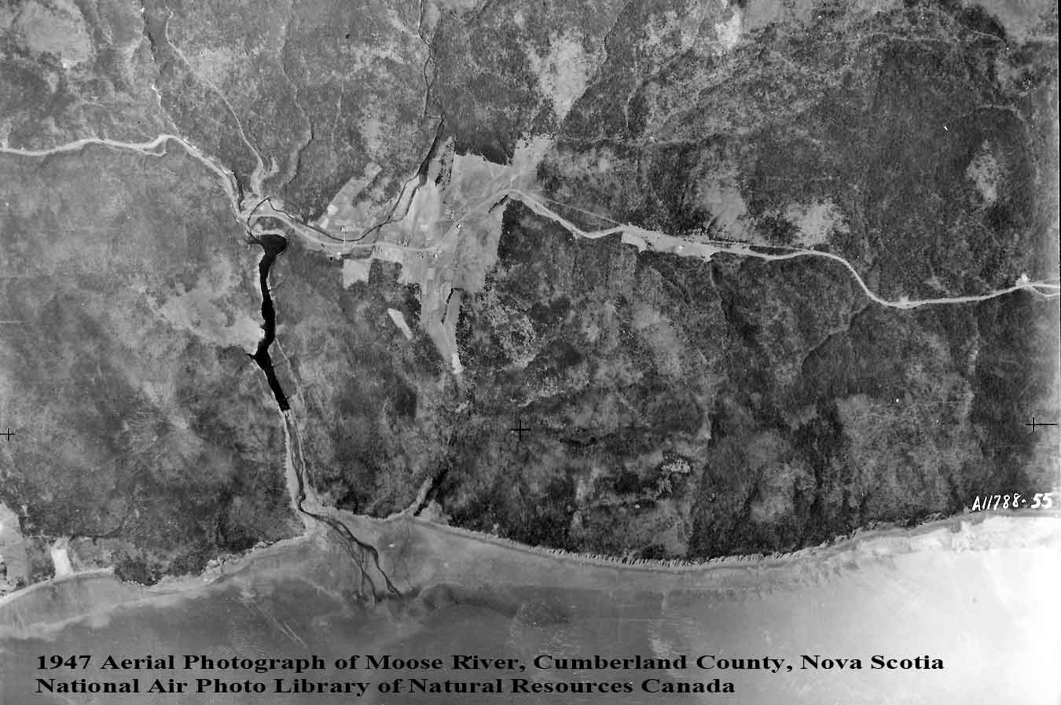
Moose River Estuary

Slide 21
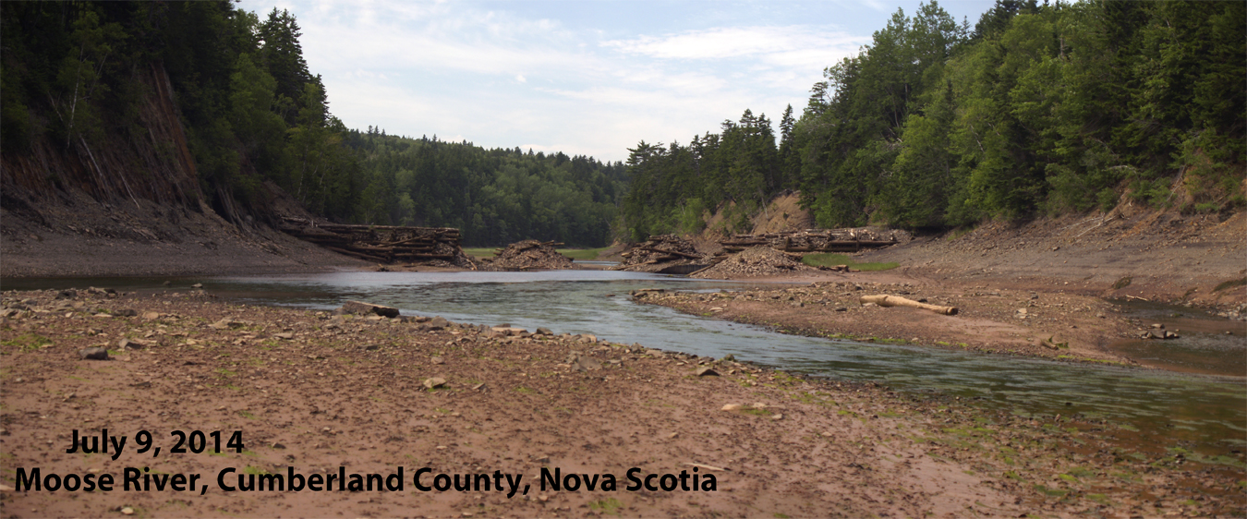

Slide 22
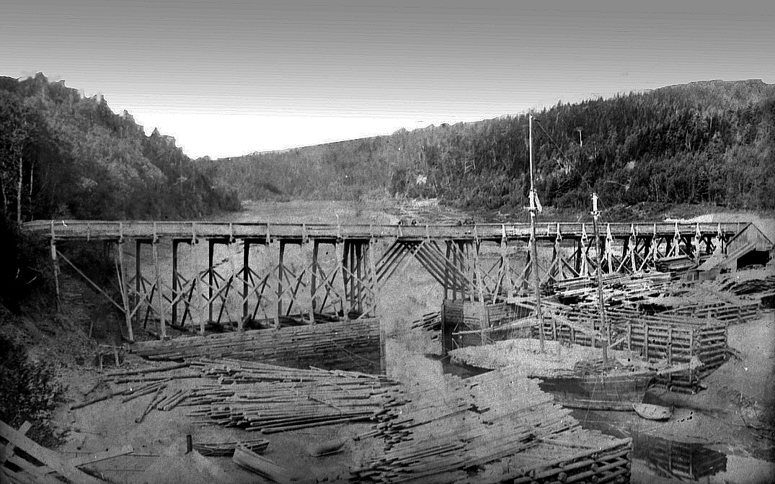

Slide 23
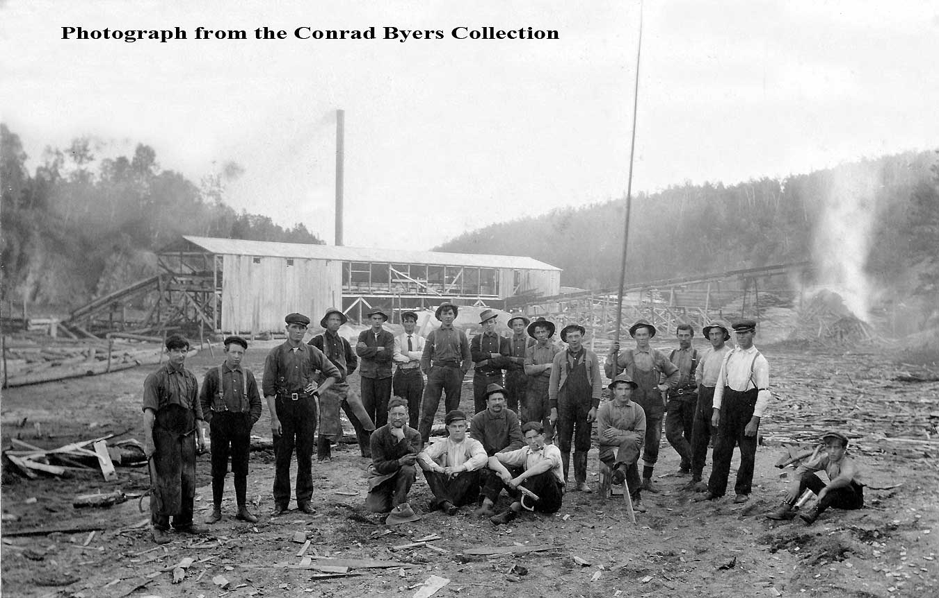

Slide 24
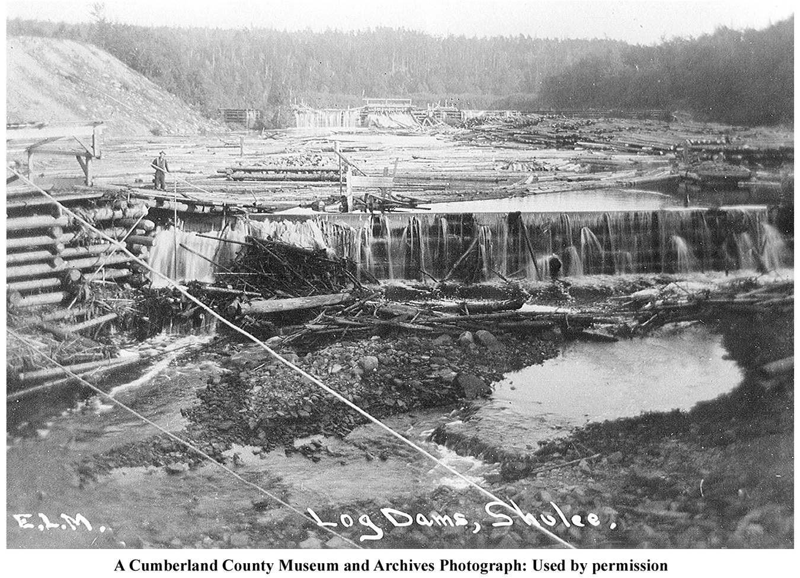
Timber Driving Dam

Slide 25
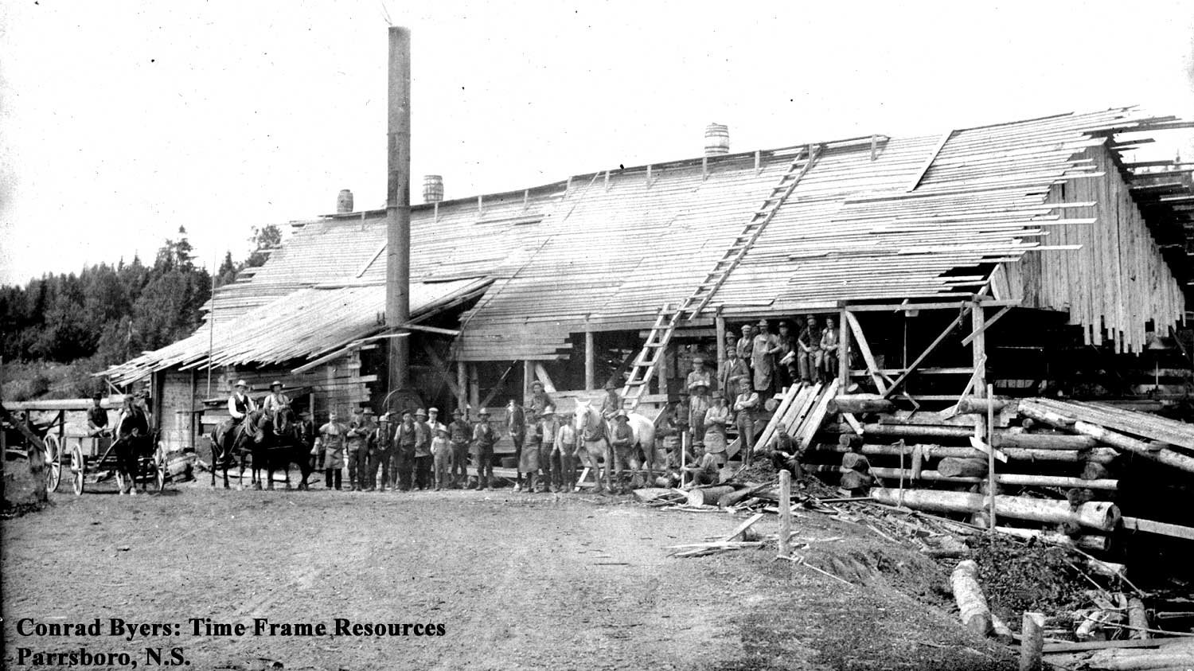
Portable Steam Sawmill or an early Stationary Steam Mill

Slide 26
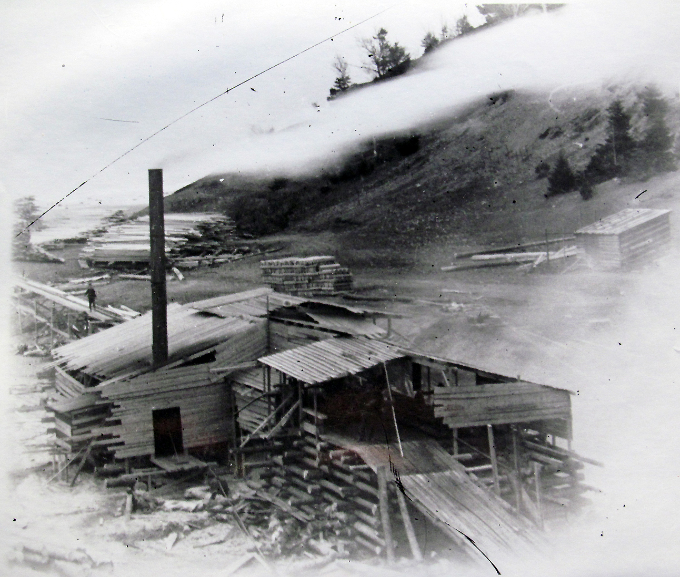
A Portable Steam Sawmill

Slide 27
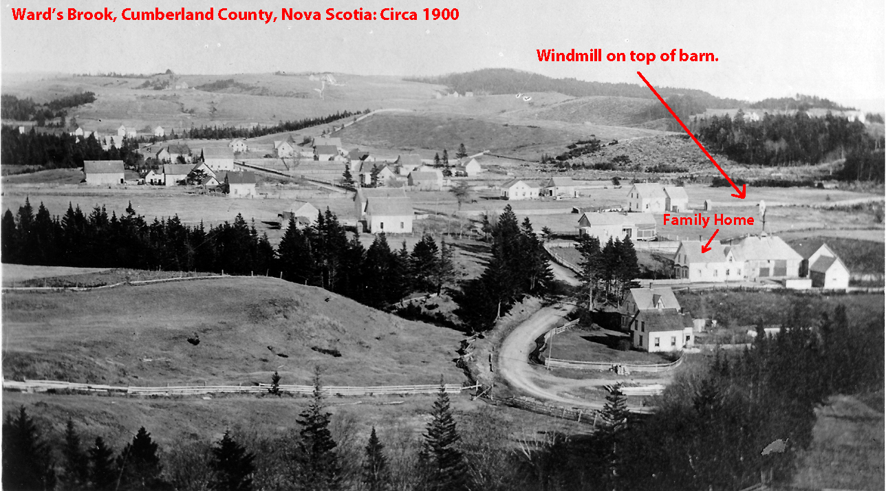
Windmill at Port Greville

Slide 28
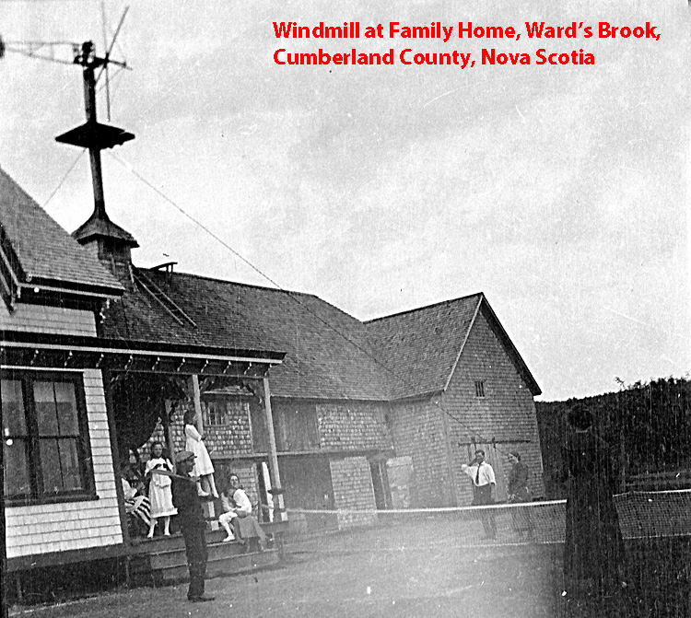

Slide 29
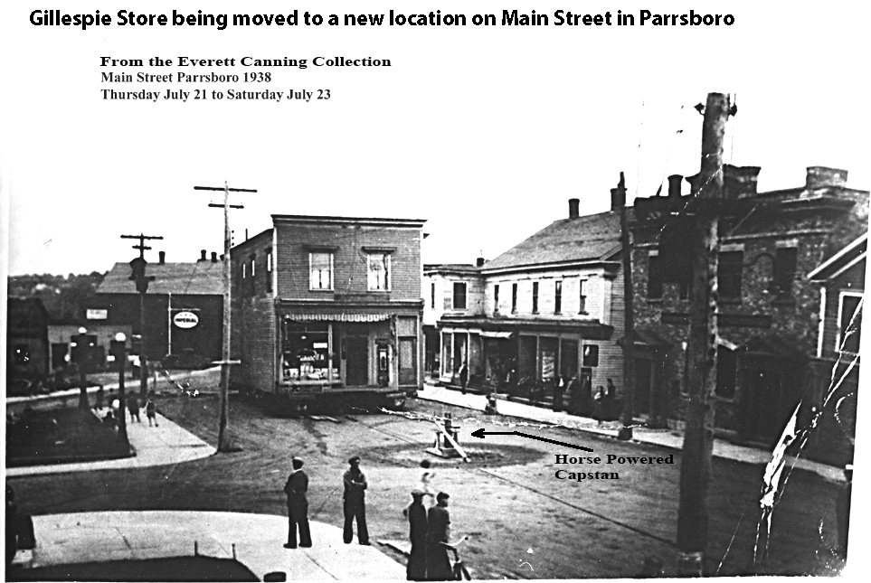

Slide 30
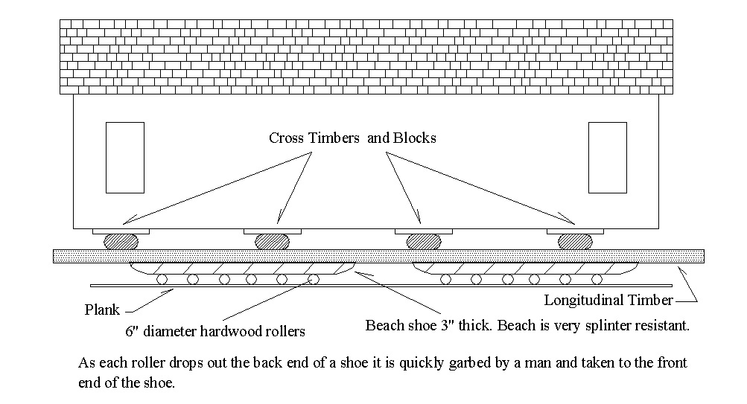

Slide 31
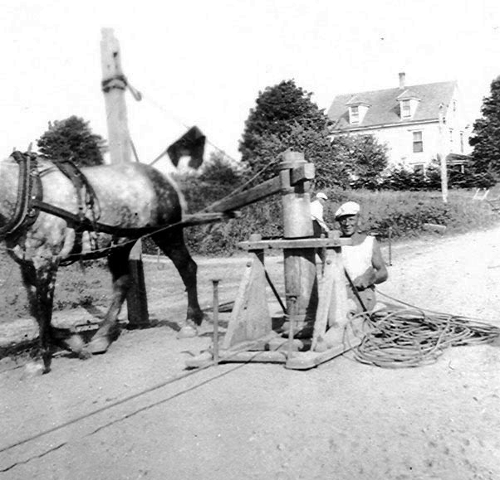

Slide 32
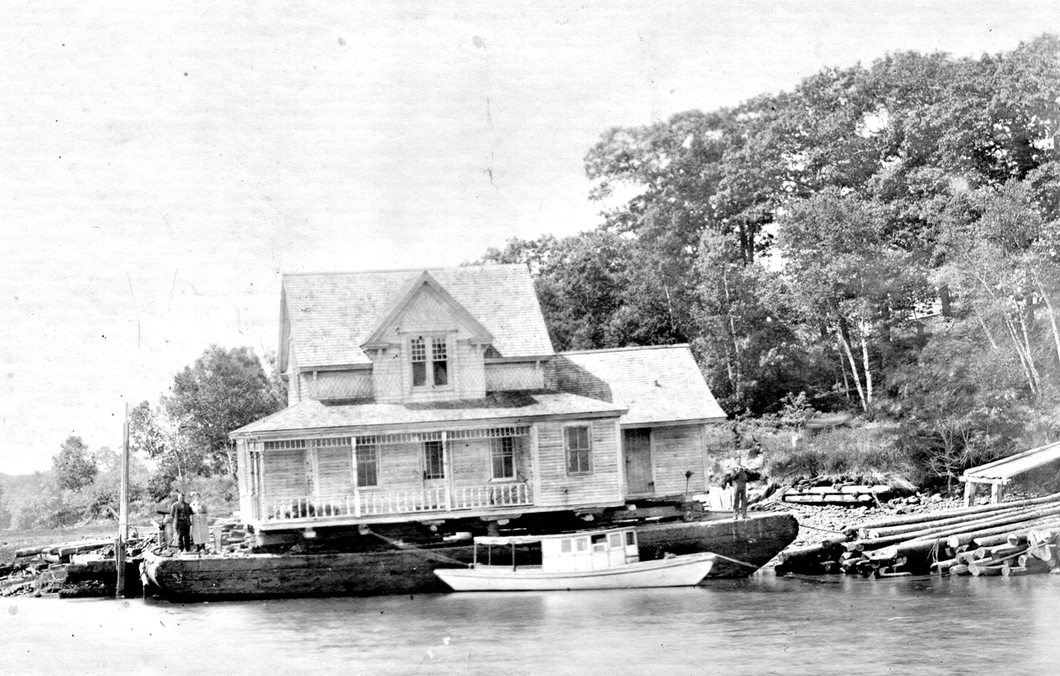

Slide 33
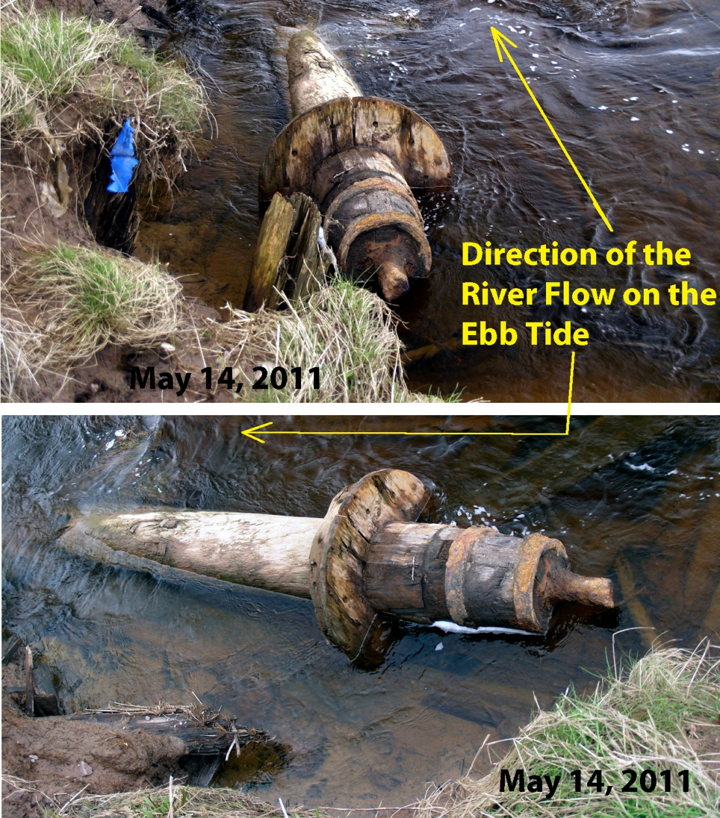
Apple River: The remains of two sawmills emerge from the banks of an eroding salt marsh.

Slide 34
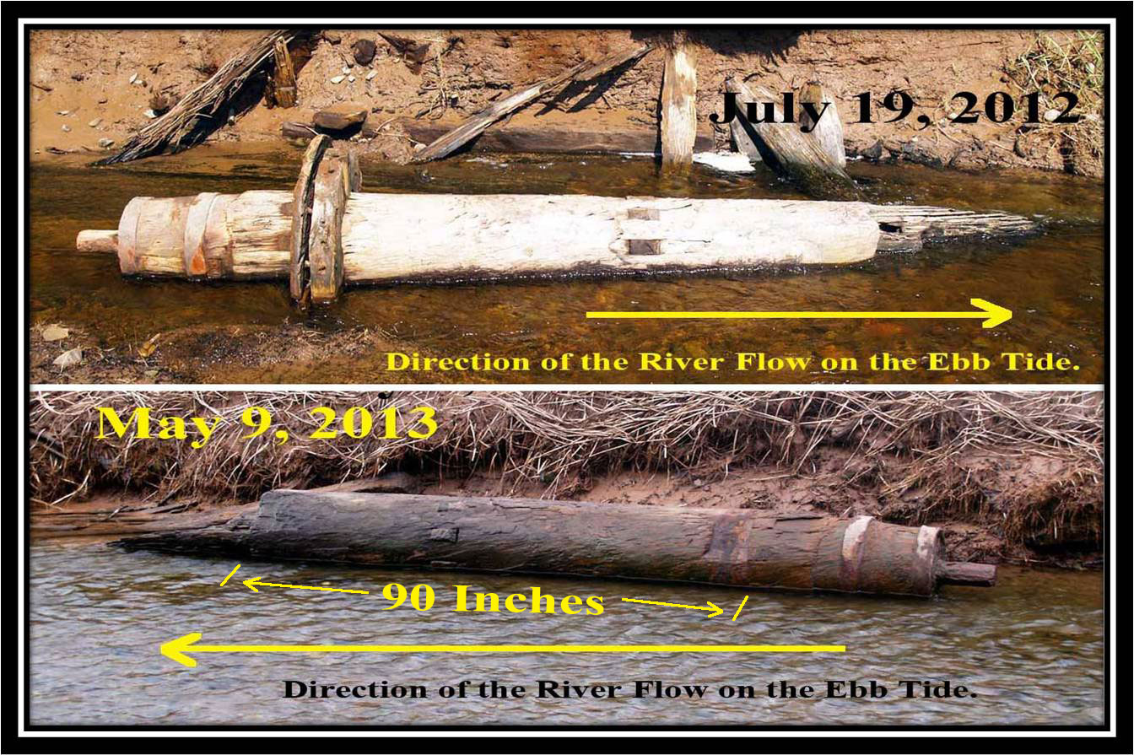

Slide 35
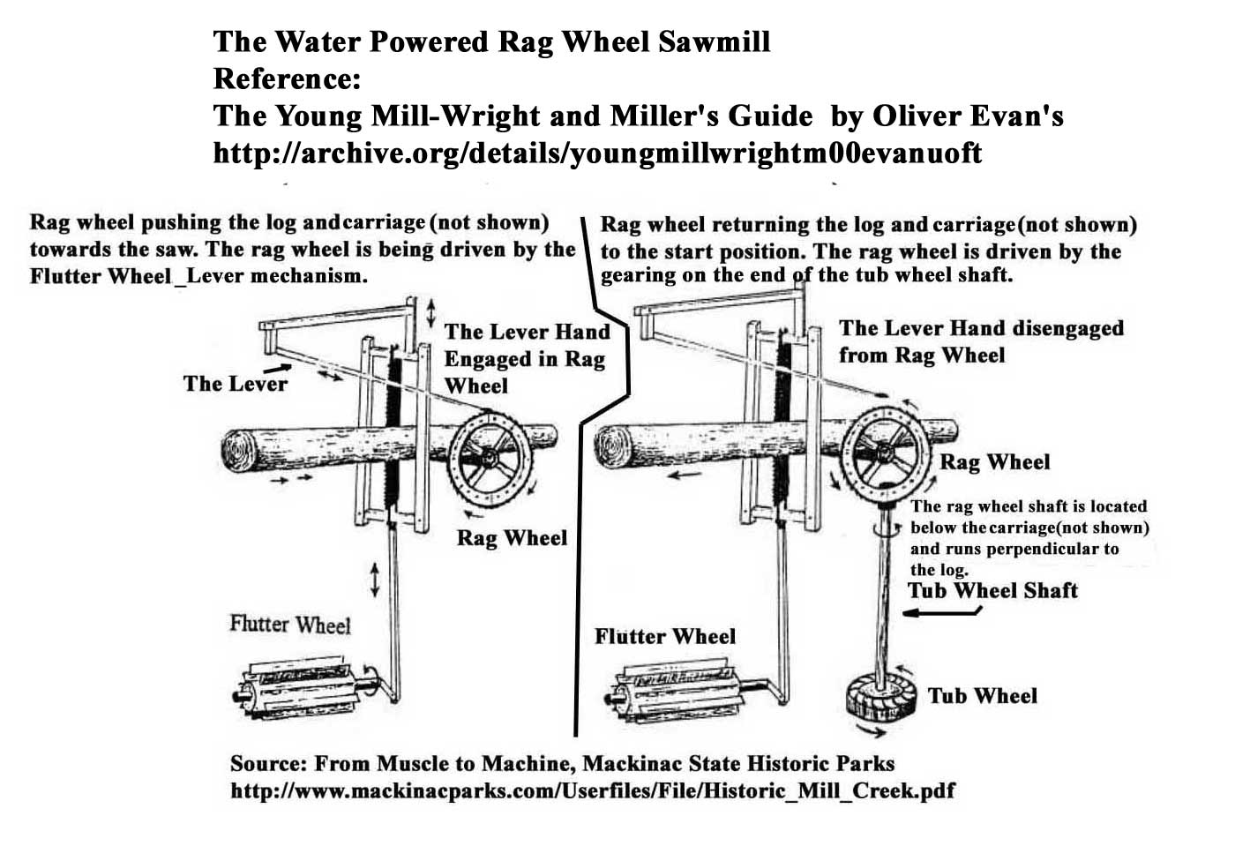

Slide 36
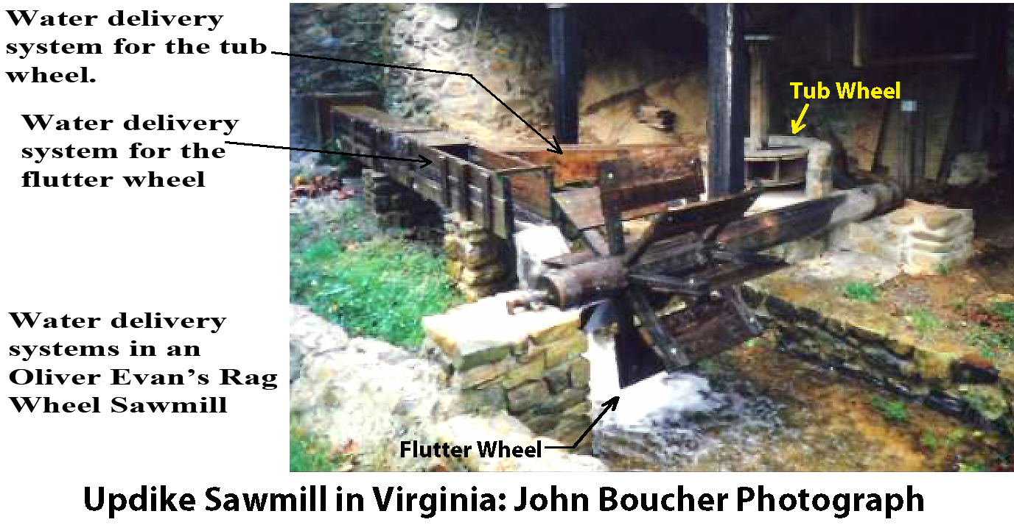

Slide 37
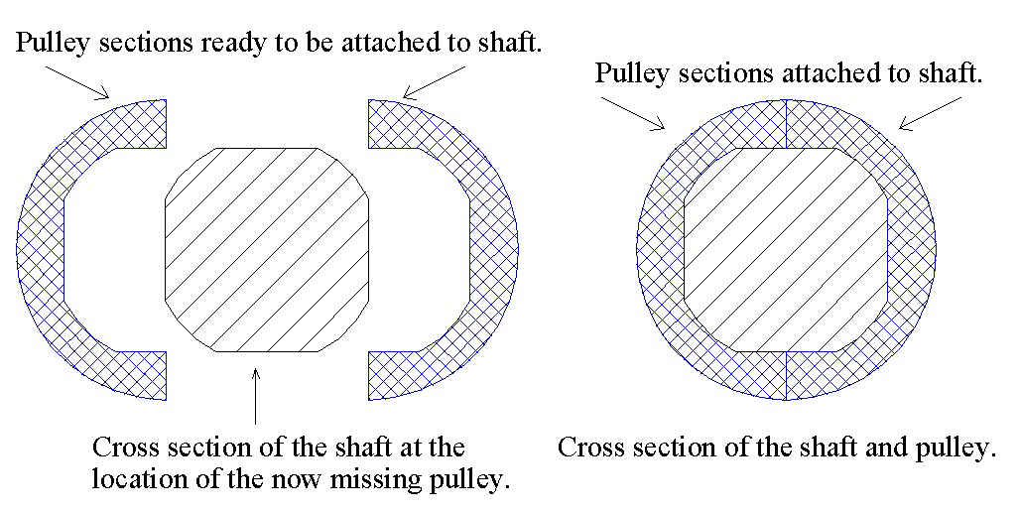

Slide 38
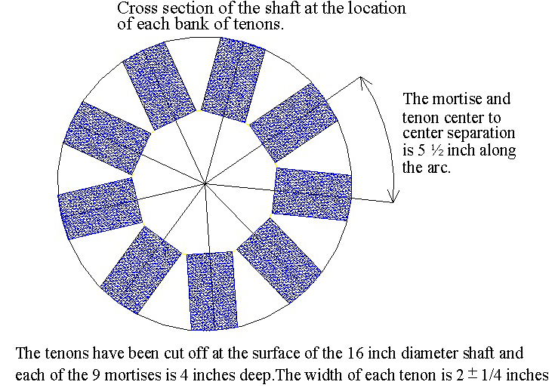

Slide 39
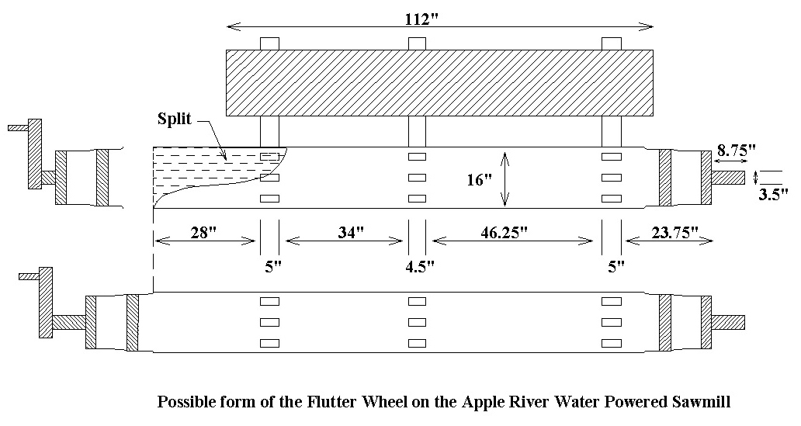

Slide 40
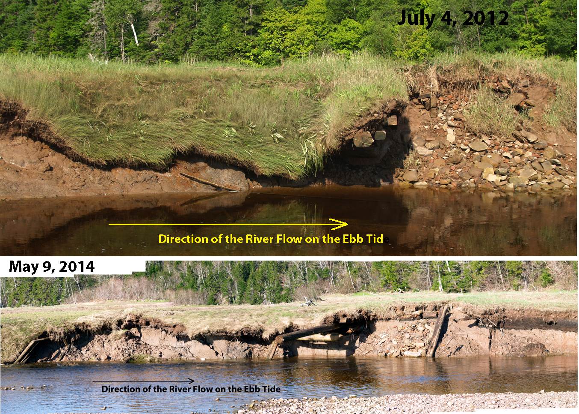

Slide 41
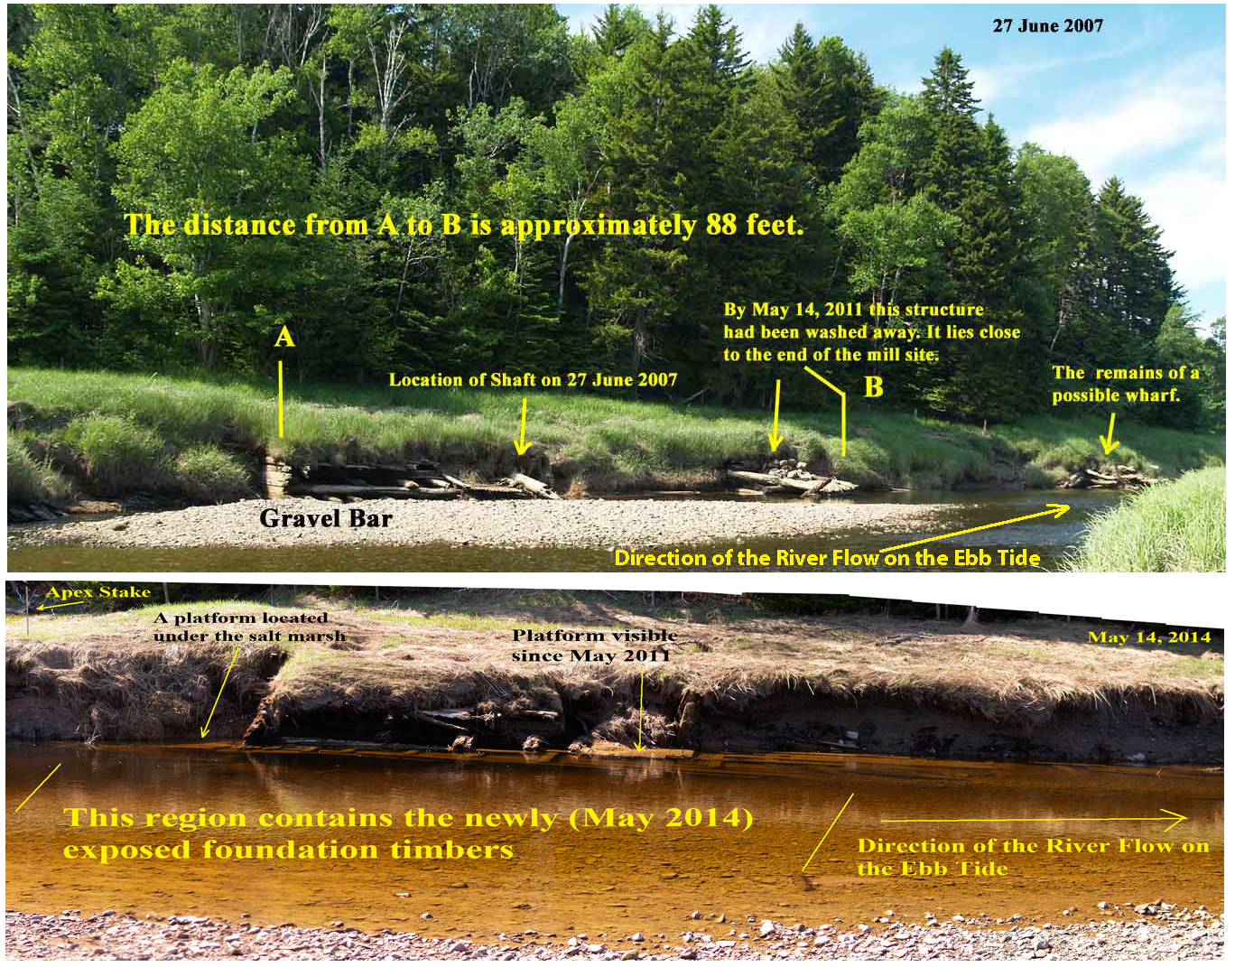

Slide 42
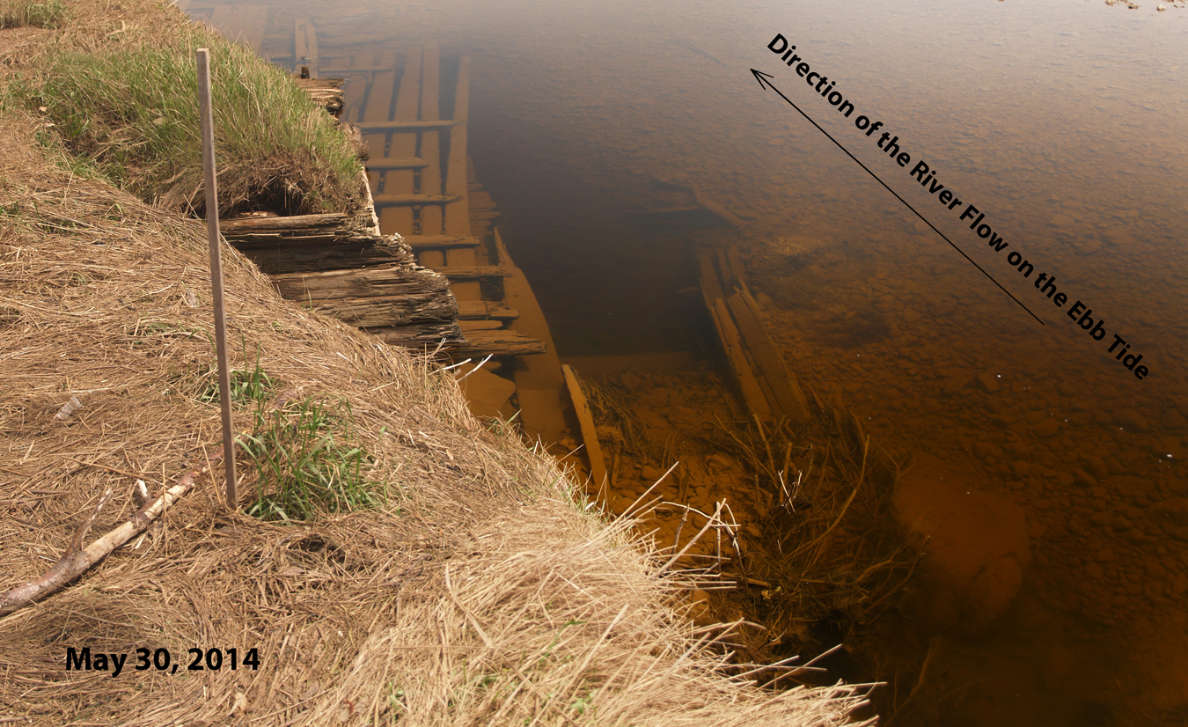

Slide 43
Millpond enclosures built on Salt Marshs by constructing sod walls in the manner of a so-called running dyke. A running dyke is a dyke wall that runs from one aboiteau (tide gate) to the next aboiteau. See slide 8.
Notes:
1) Albert C. Elderkin and his wife Lucy B. Elderkin to Isaac Spicer.. “the following lot of land beginning at the flood flume near William Rufus Elderkin’s mill then running southerly along the South east side of his millpond dyke.. Book 14, page 289, Parrsborough Registry of Deeds

Slide 44
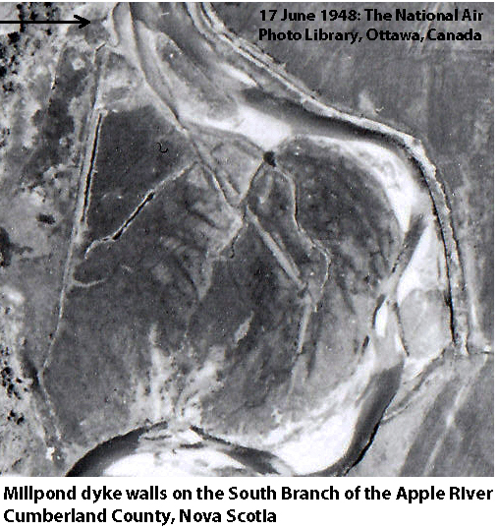
Mill
Site

Slide 45
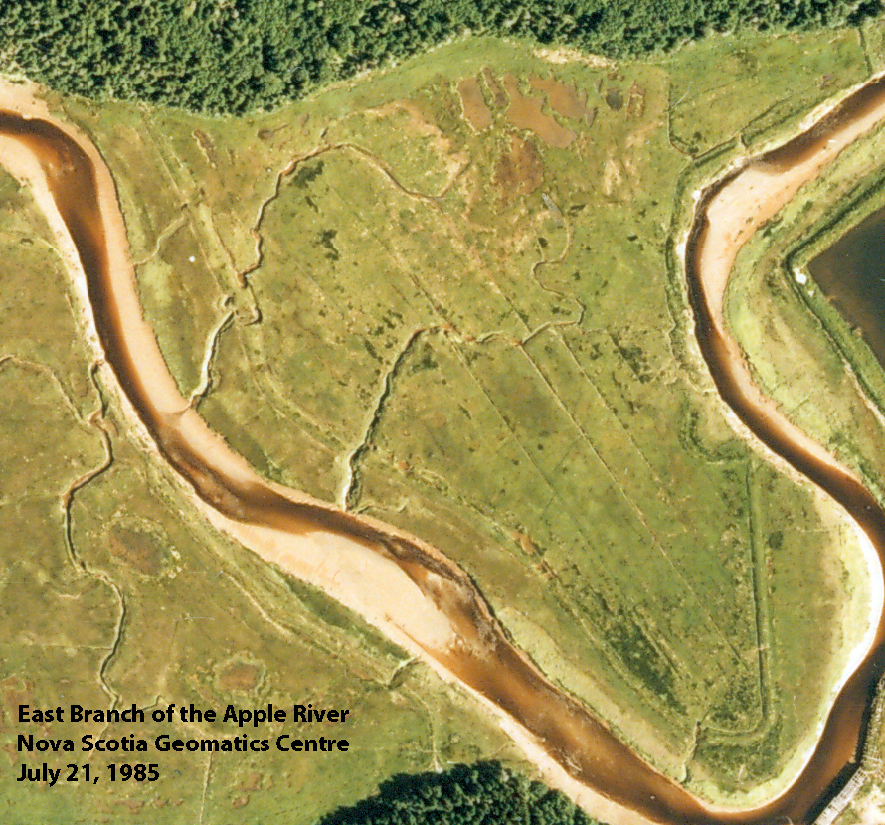

Slide 46
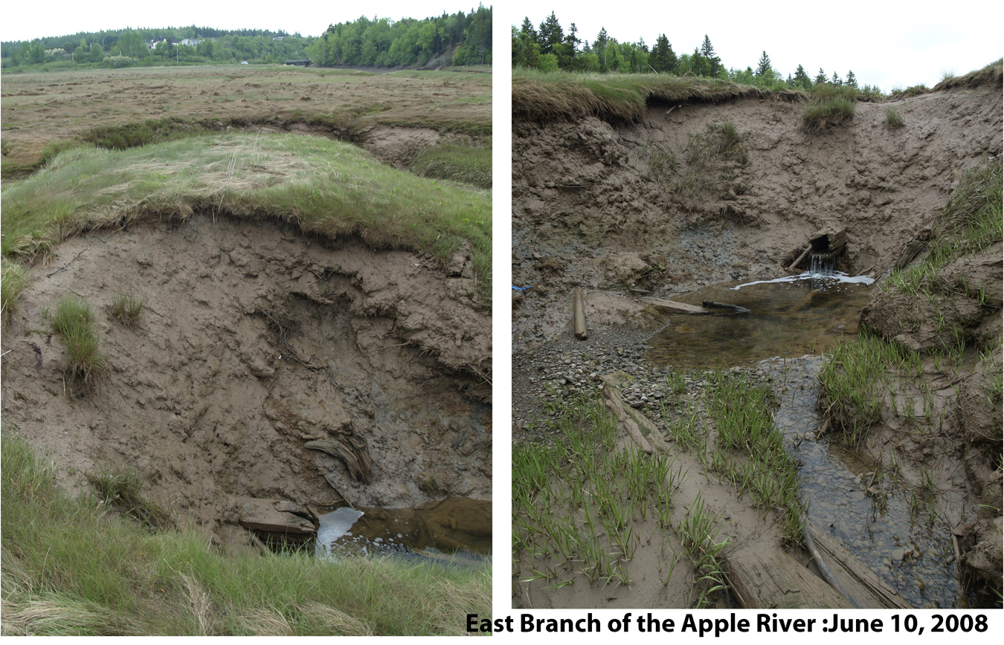

Slide 47
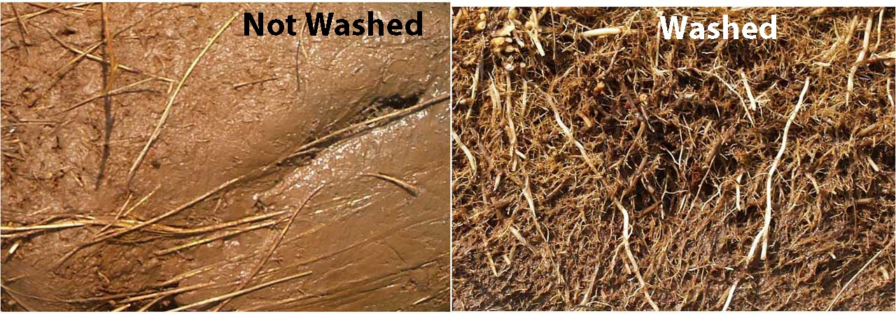
The Salt Marsh Substrate
A firm, wiry, entangled matrix of salt-tolerant plant roots packed with fine silt. Smooth faced, symmetrical and homogeneous sod bricks for building dyke walls can be cut from this substructure (Bleakney, Chapter Four).
Notes:
Bleakney, J. S. (2004). Sods, soil, and spades : the Acadians at Grand Pré and their dykeland legacy. Montreal, McGill-Queen's University Press.

Slide 48
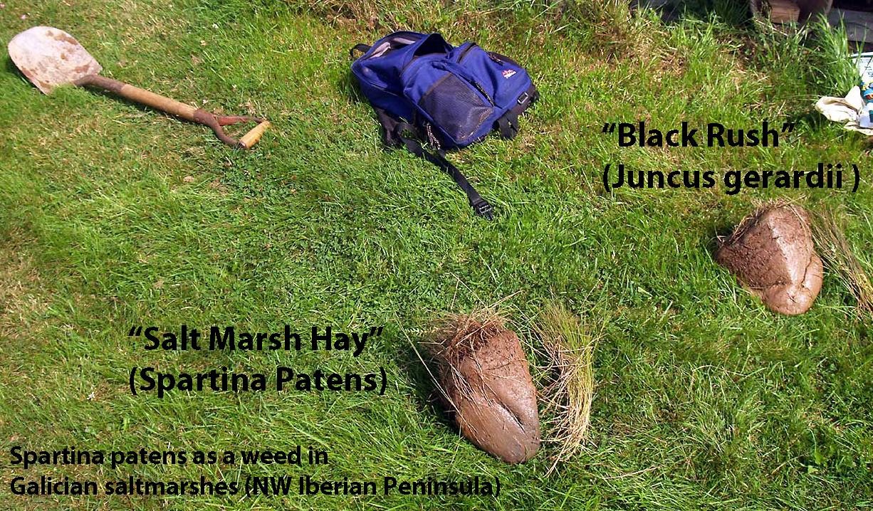
Notes:
Hydrobiologia 415: 213–222, 1999.
J. M. Caffrey, P. R. F. Barrett, M. T. Ferreira, I.S. Moreira, K. J. Murphy & P. M. Wade (eds),
Biology, Ecology and Management of Aquatic Plants.
© 1999 Kluwer Academic Publishers. Printed in the Netherlands.
213
Spartina patens as a weed in Galician saltmarshes (NW Iberian Peninsula)
D. G. SanLe´on1;_, J. Izco1 & J.M. S´anchez2
1Laboratorio de Bot´anica, Facultade de Farmacia - Universidade de Santiago de Compostela, E-15706 Spain
E-mail: bvdgslce@uscmail.usc.es
2E.U. de Ingenier´ia T´ecnica Forestal, Universidad de Vigo, E-36005 Pontevedra, Spain

Slide 49
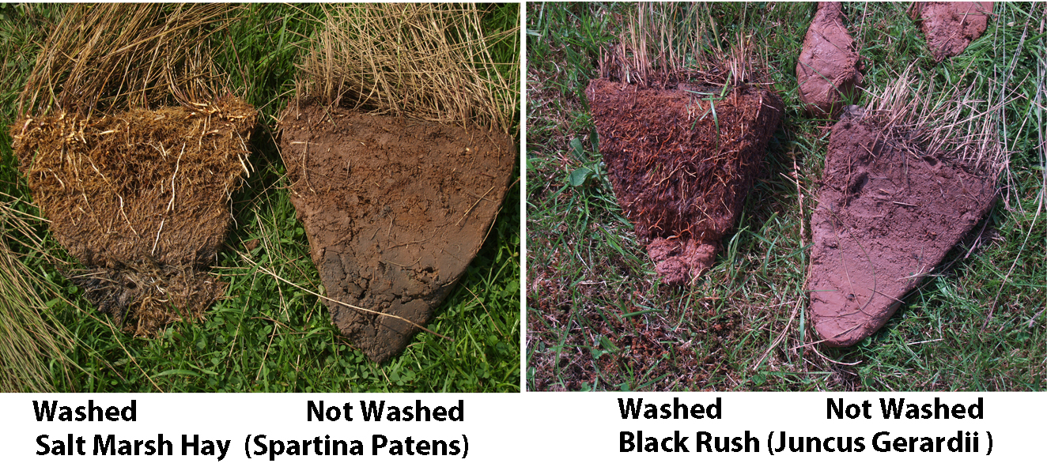
Sods cut with a knife and washed with a
garden hose.

Slide 50
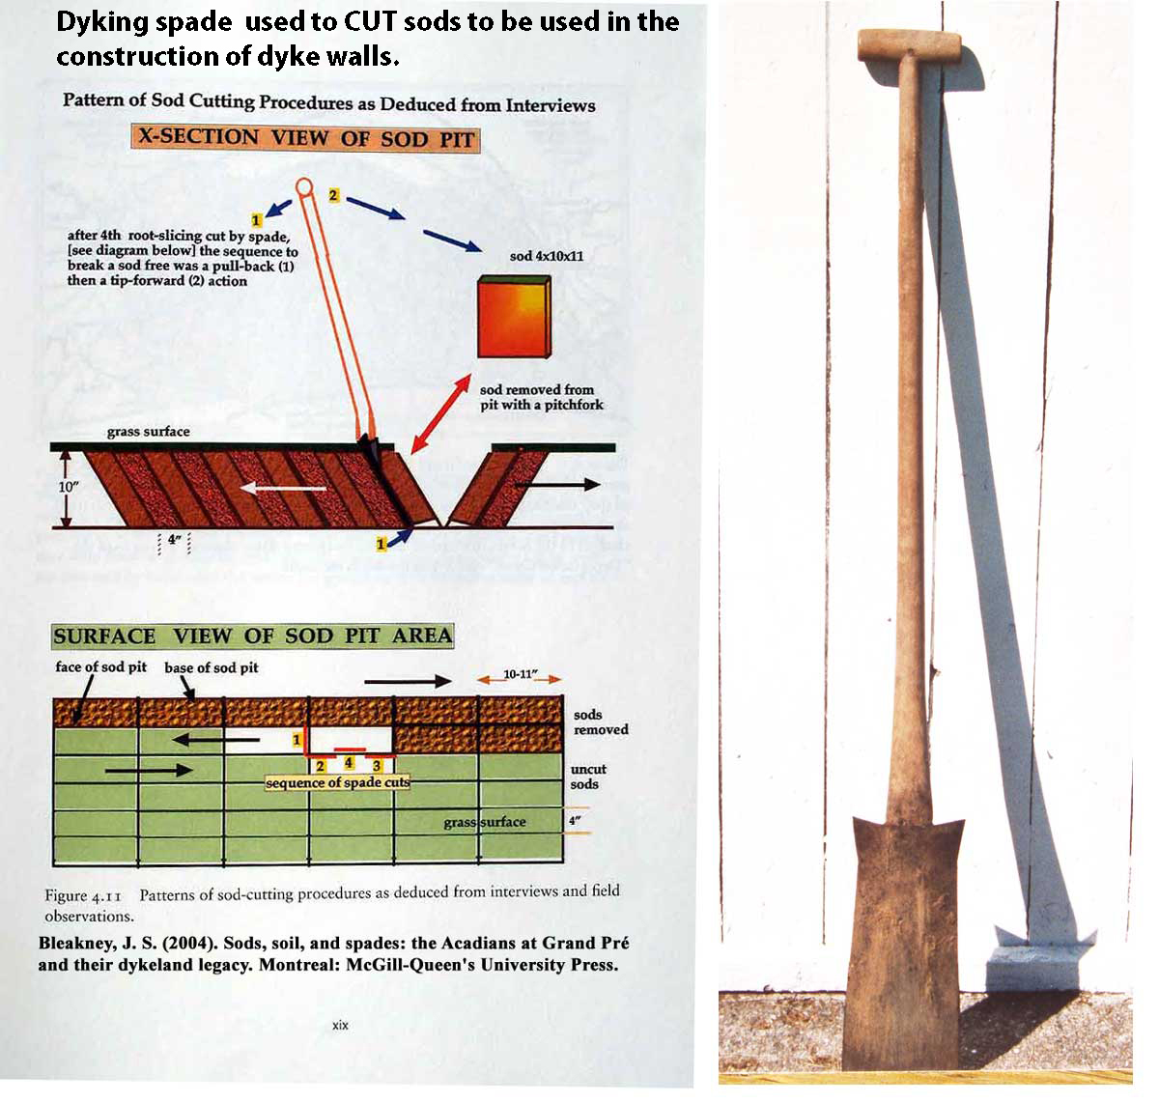

Slide 51
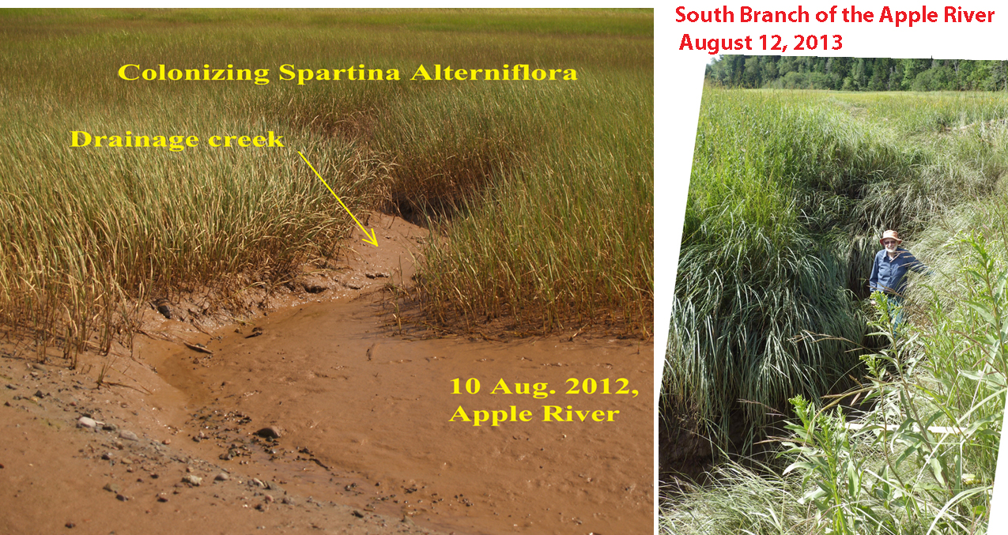
Formation of Salt Marshes and Salt Marsh Drainage Creeks
Notes:
Cycles of saltmarsh extension and contraction, Cumberland Basin, Bay of Fundy, Canada
Jeff Ollerhead, Robin Davidson-Arnott and Angela Scott
ResearchGate
http://www.uoguelph.ca/geography/faculty/robin/pubs/Ollerheadetal2005.pdf
http://www.researchgate.net/publication/233986222_Cycles_of_saltmarsh_extension_and_contraction_Cumberland_Basin_Bay_of_Fundy_Canada

Slide 52
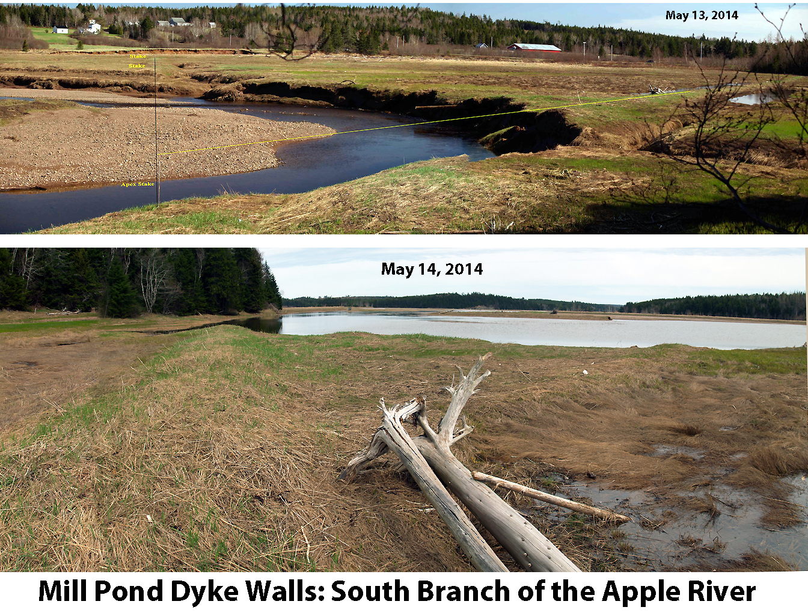

Slide 53
References
Notes:
References
Bleakney, J. S. (2004). Sods, soil, and spades : the Acadians at Grand Pré and their dykeland legacy. Montreal, McGill-Queen's University Press.
Butzer, K. W. (2002). "French Wetland Agriculture in Atlantic canada and Its European Roots: Different Avenues to Historical Diffusion." Annals of the Association of American Geographers 92(3).
Cooney, E. W. (1991). "Eighteenth Century Britain's Missing Sawmills: A Blessing in Disguise?" Construction History 7.
Cooney, E. W. (1998). "Eighteenth Century Britain's Missing Sawmills: A Return Visit1." Construction History 14.
D. G. SanLe, J. I., J.M. Sanchez (1999). "Spartina patens as a weed in Galician saltmarshes (NW Iberian Peninsula)." Hydrobiologia 415: 213–222.
On the web at
http://link.springer.com/chapter/10.1007%2F978-94-017-0922-4_30#page-1
Grant, D. R. (1970). "Recent Coastal Submergence of the Maritime Provinces, Canada." Canadian Journal of Earth Sciences 7: 676.
Hatvany, M. G. (2002). "The Origins of the Acadian Aboiteau: An Environmental-Historical Geography of the Northeast." Historical Geography 30.
On the web at
http://www.historical-geography.net/volume_30_2002/hatvany.pdf
Hatvany, M. G. (2003). Marshlands : four centuries of environmental change on the shores of the St. Lawrence. Sainte-Foy, Quebec :, Presses de l'Université Laval.
Hunter, D. (2012). The Race to the New World: Christopher Columbus, John Cabot, and a Lost History of Discovery. Vancouver, Douglas & McIntyre, An imprint of D&M Publishers INC.
J. Pluet and P.A. Pirazzoli (1991). World Atlas of Holocene Sea-Level Changes. Amsterdam, Elsevier Science Publishers, B. V., Oceanography Series.
Robert J. Nicholls and Anny Cazenave (2010). "Sea-Level Rise and Its Impact on Coastal Zones." Science 328.
On the web at
http://www.webpages.uidaho.edu/envs501/downloads/Nicholls%20%26%20Cazenave%202010.pdf
Sebold, K. R. (1992,
). "FROM MARSH TO FARM:
The Landscape Transformation of Coastal New Jersey." Historic American Buildings Survey/Historic American Engineering Record Retrieved 7 July 2010, from
http://www.nps.gov/history/history/online_books/nj3/contents.htm.

